Slide 1
Deep Dive into Active Learning
Train neural networks more efficiently with less data
Christian Normand

Slide 2
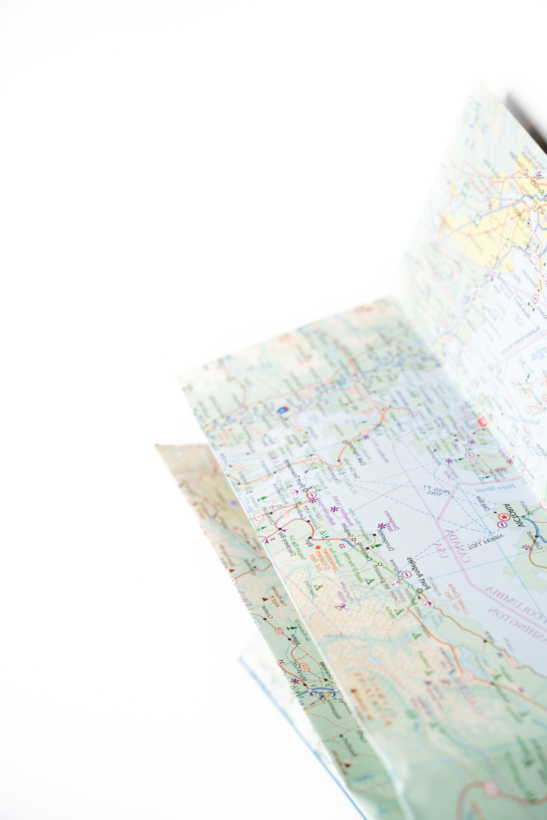
Roadmap
Introduce problem statement
Define active learning
Review experiment
Discuss results
Reflect on lessons learned
Notes:
Just so you know where we’re headed:

Slide 3
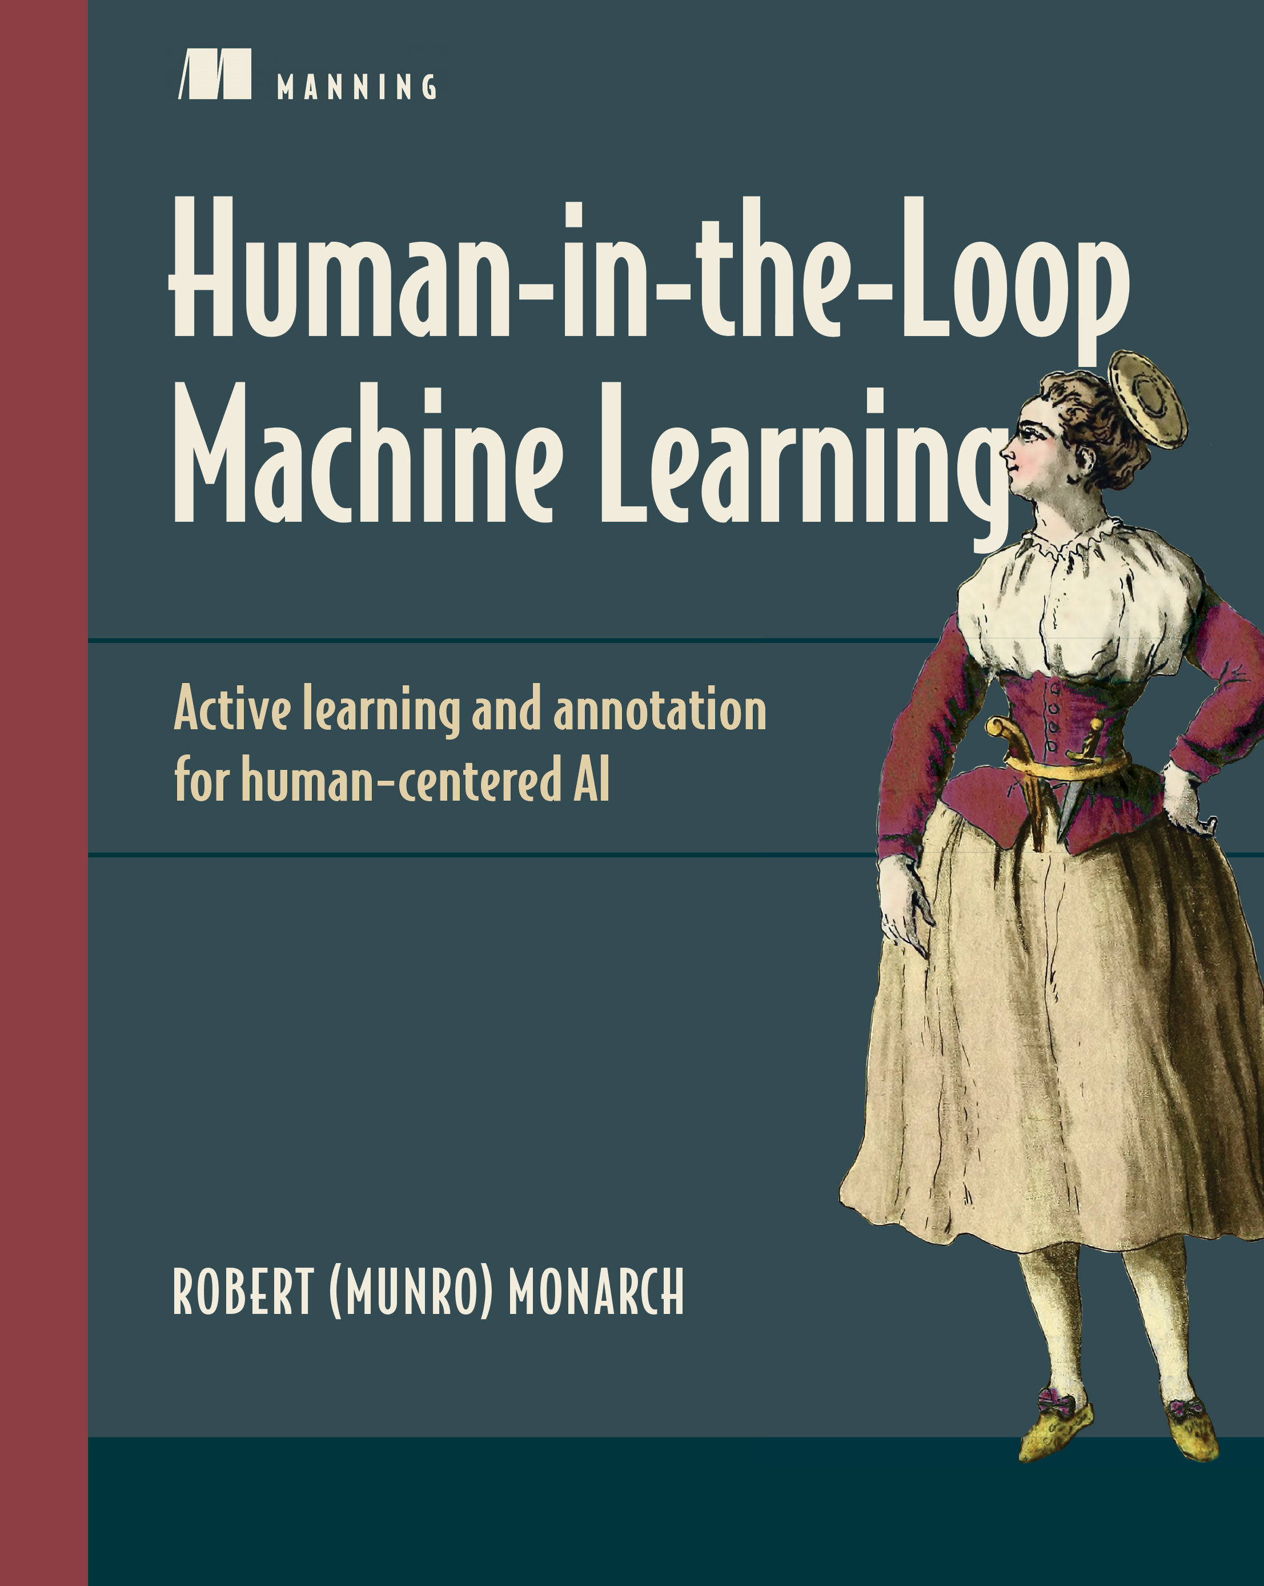
Read this book
Human-in-the-Loop Machine Learning
By Robert (Munro) Monarch.
This book provided the inspiration for this project. It’s all about active learning, and more generally, how humans and machine learning algorithms interact.
Check it out here!
Notes:
I do want to give a shout out to Human-in-the-Loop Machine Learning by Robert Monarch.
This book pretty much inspired this project
Currently reading it, a lot of great, practical stuff about the intersection of humans and AI
I think it’s fascinating. If you’re intrigued by anything in this presentation, I’d definitely recommend checking out this book.

Slide 4
Problem statement: Can active learning techniques be used to reduce the amount of training images required for a convolutional neural network (CNN) to reach target accuracy?
Notes:
On to the problem statement –
I went into this project trying to answer this question:
Read problem statement.
If you consider a situation where you have lots of unlabeled images that you need people to assign labels to…
It could be very valuable to reduce the number of images you need to label.

Slide 5
Define Active Learning
Notes:
Let’s move into defining active learning.

Slide 6

Active learning: What is it?
Supervised learning requires labeled data.
Active learning comprises a set of techniques for selecting the data you will use to train your model.
Allows you to reach target accuracy with fewer labeled data points.
Can be used to periodically retrain models to adapt to changing data.
Notes:
Active learning is a set of techniques that allows you to train your models more efficiently and with less data.
As I mentioned, this has a lot to do with labeling data.
Active learning gives you a way to choose which data gets labeled and subsequently added to the training dataset.
And I should also mention, it’s common to implement active learning on a continual basis to periodically retrain models to adapt to
Changes in the data landscape.

Slide 7








Example: Consider a blogging website that’s trying to detect aggression in its comment section.
A traditional approach to labeling data might look like this:
(a) aggressive
(b) not aggressive
Data scientists sample comments from a large collection of blog posts
Comments are selected at random
Annotators label each comment as aggressive or not aggressive
Data scientists train a model using the labeled data
Notes:
I’d like to give an example of how this works.
Consider a blogging website that’s trying to detect aggression in its comment section.
That’s a little throwback to project five – but it goes to show, this is something that’s actually being done.
A traditional approach to labeling data and training a model would look like this:

Slide 8
Example: Consider a blogging website that’s trying to detect aggression in its comment section.
An active learning approach
would look more like this:
(a) aggressive
(b) not aggressive
Annotators label each comment as aggressive or not aggressive
Data scientists train a model using whatever labels they have
Data scientists sample comments from a large collection of blog posts
A small batch of comments is selected at random
Data scientists intelligently select the next batch of samples to annotate based on results from the model
Notes:
In the same scenario, you could implement an active learning strategy that might look something like this:

Slide 9
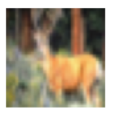
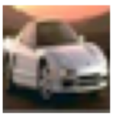
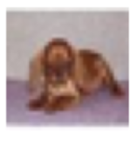
Active learning techniques
Uncertainty sampling
Sampling data that’s most confusing for the model.
Input
Model says:
91% sure that’s a deer.
99% sure that’s a car.
51% sure that’s a cat…
but maybe it’s another deer.
Notes:
I’m going to briefly introduce two common techniques for choosing which data gets sent for annotations.
The first is Uncertainty sampling.
Picking data that’s most confusing for the model
Say you’ve trained a model on a little bit of data, and you then feed the entire collection of unlabeled data for predictions
Here are a few things you get out – now remember, this is all unlabeled data, so we’re not checking whether or not the model’s right.
We’re looking at how confident the model is in whatever it predicted.

Slide 10
Active learning techniques
Uncertainty sampling
Sampling data that’s most confusing for the model.
Input
Model says:
91% sure that’s a deer.
99% sure that’s a car.
sample
this →
51% sure that’s a cat…
but maybe it’s another deer.
Notes:
I want to get a label for this datapoint – because these datapoints that are really uncertain are going to
Push the decision boundary for the model a lot more than these other ones that the model is already pretty confident about.
Of course, there are a handful of methods for carrying this process out, and there are certain considerations for multiclass vs binary,
We’re looking at how confused is the model.

Slide 11
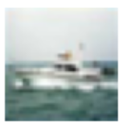
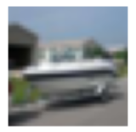
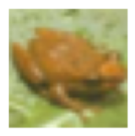
Active learning techniques
Uncertainty sampling
Sampling data that’s most confusing for the model.
Diversity sampling
Sampling data that’s the most different from what the model has already seen.
Input
Model says:
Input
Model says:
91% sure that’s a deer.
That’s a boat!
99% sure that’s a car.
That’s another boat!!!
51% sure that’s a cat…
but maybe it’s another deer.
That’s a frog… but I haven’t
seen many frogs before
Notes:
The next common technique is called diversity sampling
This is sampling data that’s most different than what the model’s already seen.
Pulling this off is a little more complicated than uncertainty sampling
Oftentimes it involves clustering, but there are ways to do it by looking at how strong the activation is in the case of neural nets
For something the model has seen a lot of – you’re going to get strong activation of certain neurons.
But for something that’s relatively unknown to the model, the activation will be weaker.

Slide 12
Active learning techniques
Uncertainty sampling
Sampling data that’s most confusing for the model.
Diversity sampling
Sampling data that’s the most different from what the model has already seen.
Input
Model says:
Input
Model says:
91% sure that’s a deer.
That’s a boat!
99% sure that’s a car.
That’s another boat!!!
51% sure that’s a cat…
but maybe it’s another deer.
That’s a frog… but I haven’t
seen many frogs before
sample it.
Notes:
I’d want to label the frog and add it to the training set. There are lots of benefits to making sure your samples are diverse, but ultimate goal is to create robust model.

Slide 13
Review experiment
Notes:
This is not just a lecture on active learning – I conducted an experiment that I will talk about… right now.

Slide 14
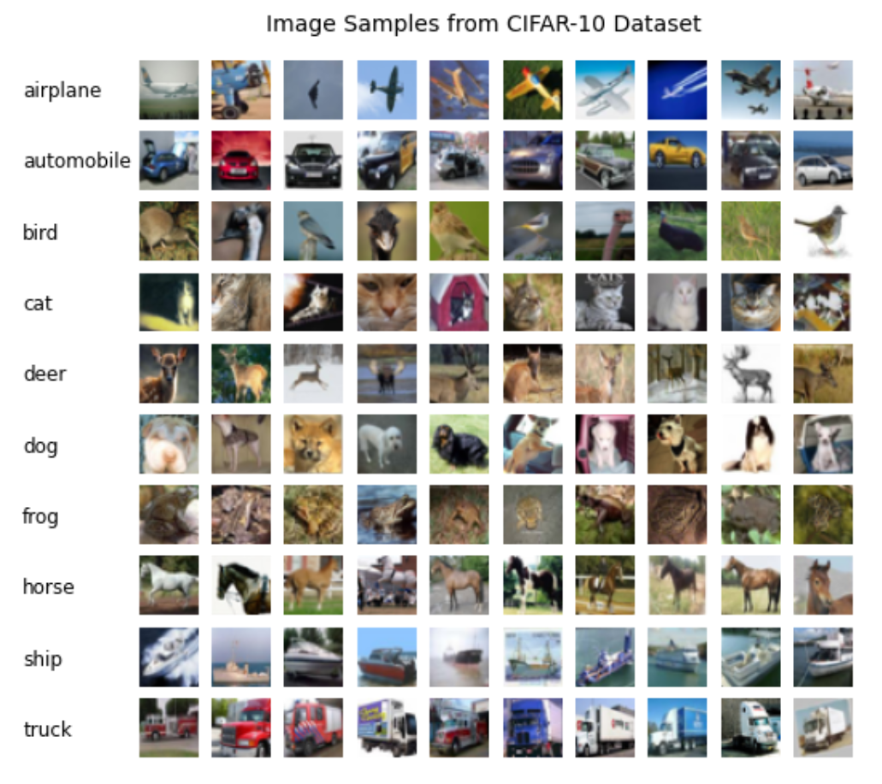
The CIFAR-10 Dataset
60,000 tiny images evenly split into ten categories
I used 49,000 for training, 1,000 for validation, and 10,000 for testing.
This is a commonly used dataset for image classification. There are plenty of models out there that have achieved ~90% accuracy.
Notes:
This is the dataset that I used – there are a lot of tiny images divided into ten exciting categories.
There is an API that lets you download this dataset directly in tensorflow, but you can also get it right from the source, which was the University of Toronto.

Slide 15
The model
I used a convolutional neural network with one hidden layer.
The model maxed out at 50% accuracy.
I chose a simpler model to see if it would be faster to train, acknowledging it could impact accuracy.
Convolutional 2D layer
Convolutional 2D layer
Max pooling layer
Flatten
Dense 128 neuron layer
10 neuron output (softmax)
Notes:
The model I used topped out at 50%, which is still much better than baseline of just guessing.
But I chose a simpler model because it would be faster to train – and that ended up being a big deal, as you’ll see.

Slide 16
Methodology
Try different percentages of uncertainty sampling [0%, 10%, 20%... 100%], and see how that affects the time it takes for the model to reach 50% accuracy.
Diversity sampling would have been interesting to implement as well, but that’ll be a future project.
Start each trial by training the model on a randomly selected batch of 1,000 images.
After the first training batch, use the uncertainty sampling protocol for that trial to add another 1,000 images to the training set.
I used margin of confidence to rank images by their level of uncertainty.
Retrain the model and repeat until the training set includes all 49,000 training images.
Run three trials for each sampling protocol.

Slide 17

Concern: Speed
The experiment consisted of 1,600+ CNNs.
Using a GPU or TPU would have been ideal but was not an option.
My laptop
Notes:
So this is a lot of convolutional neural nets.
It’s basically like doing a huge grid search an it was clear right off the bat that I would need some more computing power.

Slide 18
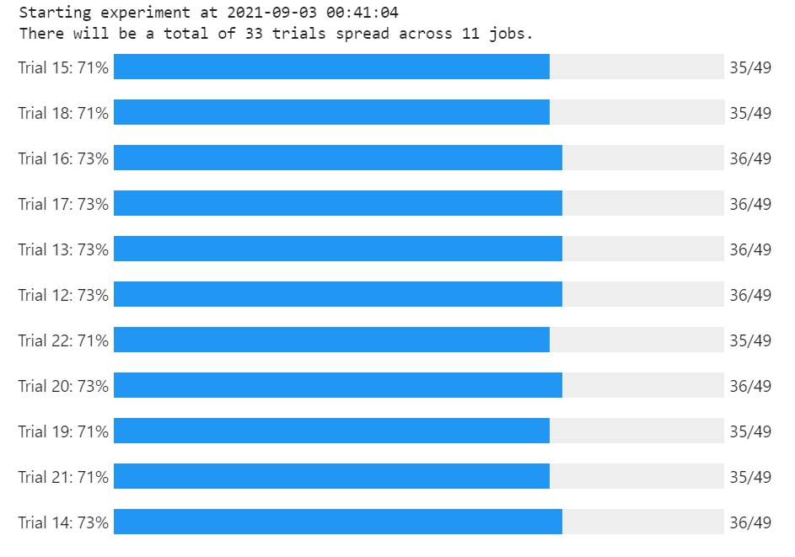
Solution: Multiprocessing
I refactored my code using the multiprocessing package and ran the experiment in a Google AI notebook with 16 CPUs
Notes:
I ended up refactoring my code to utilize multiprocessing, and then ran it in a Google AI notebook with 16 CPUs.
This was not trivial by any means – but it really helped speed things along.
Also, multiprocessing is a very useful skill.

Slide 19
Discuss results
Notes:
So after this thing ran for 24 hours, I finally had some results to look at.

Slide 20
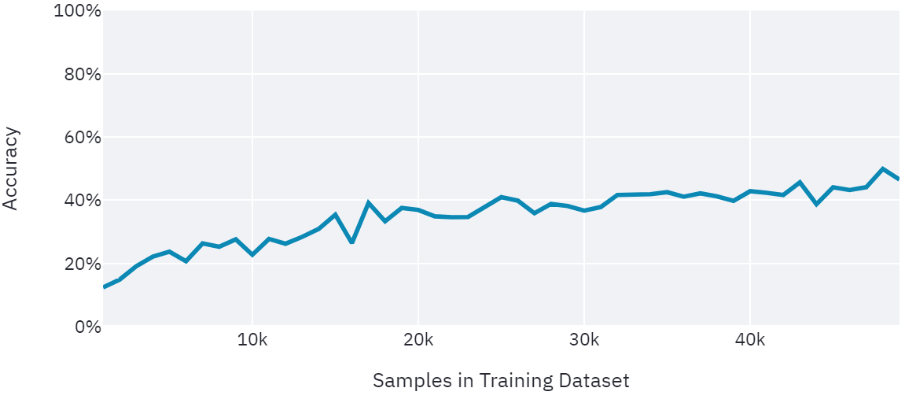
Baseline
Random Sampling Only
50% Accuracy
Notes:
And here’s what I would call the baseline.
This is the test case with no active learning, so the images that get added to the training set are random.
You can see as I added more and more images to the training set, the accuracy crept closer to 50%.
According to what I’d read, I expected this line to start looking like this as I incorporated uncertainty sampling.
That did not happen, but there are reasons for that and definitely still lessons to be learned from this project.
With that in mind…

Slide 21
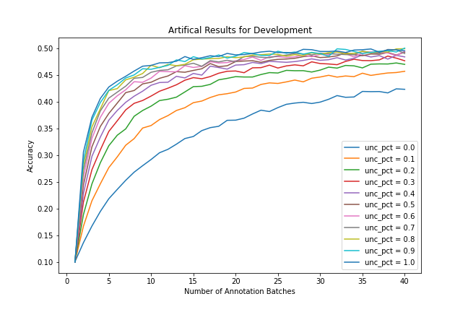
Results…?
I derived a formula to generate dummy results so I could start working on charts while the experiment was running.
This is what I hoped the results would look like.
Notes:
While the experiment was running, I derived a formula to generate dummy results just so I could work on charts and stuff.
But this is what I hoped the results would look like.

Slide 22
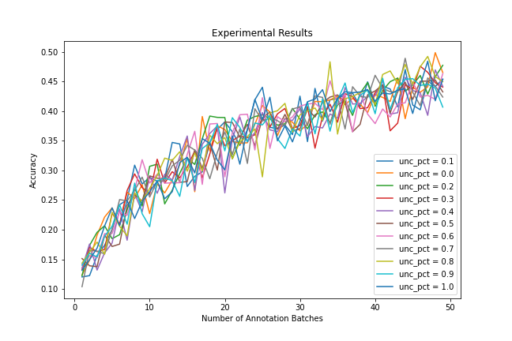
Results
I derived a formula to generate dummy results so I could start working on charts while the experiment was running.
This is what I hoped the results would look like.
This is what the results actually looked like.
Notes:
But this is what they actually looked like.
Clearly, no real difference in accuracy as I increased the uncertainty proportion.

Slide 23
Reflect on lessons learned
Notes:
So now’s a great time to reflect.

Slide 24

Why the unexpected outcome?
First guess: The model wasn’t strong enough.
Second guess: A different method of uncertainty sampling might have led to better performance.
Third guess: Incorporating diversity sampling might have led to better performance.
Notes:
Why did the results look so different from what I expected.
I’m pretty certain my first guess has a lot to do with it – and that is that the model just wasn’t strong enough.
It’s been shown that by adding more layers to the neural net, you can break 80% accuracy pretty easily – it’ll just take longer to train.
Well, my model might not have been breaking into the performance range where I would see the benefit from active learning –
So a really good improvement for week 13 would be to create a stronger model and run the experiment with that.
There are certainly other methods to uncertainty sampling that could lead to different results. I used something called margin of confidence scoring, but it would be interesting to try cross-entropy scoring or something else.
My third guess would be to add diversity sampling – I don’t think this alone is the reason for the unexpected results, but It’s something I want to try adding to the project.

Slide 25

Accomplishments
Created an object-oriented framework for running iterative experiments using any type of model.
Learned how to use the multiprocessing package and Google AI notebooks.
Continuing to learn about active learning, a very useful technique in industry.
Notes:
There are certainly some big accomplishments here.
Text annotation
Video annotation (self driving cars)
Medical diagnoses where your annotators are probably doctors.

Slide 26
Check out the Streamlit app.

Slide 27
Thank you!

